Slide 1

THE ENVIRONMENT IN WHICH PROJECTS OPERATE
Prepared by: LAVENIA ANGELINE P. ZETA

Slide 2
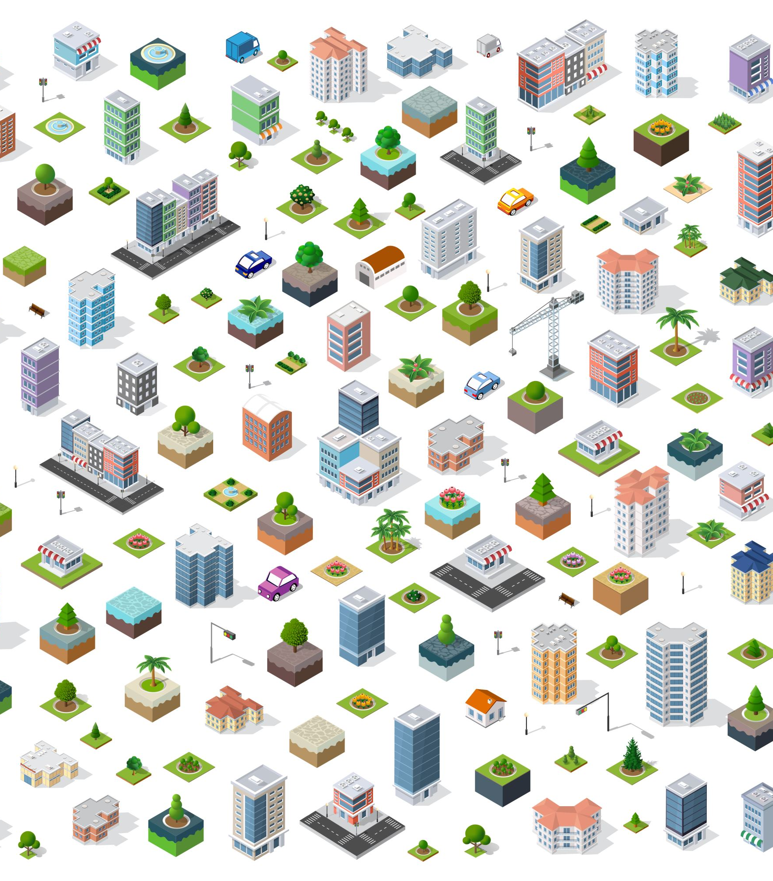
OVERVIEW

Slide 3
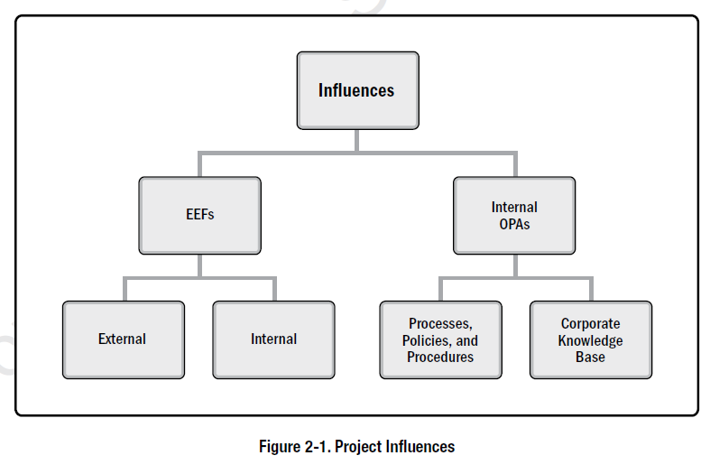

Slide 4

2.2 ENTERPRISE ENVIRONMENTAL FACTORS

Slide 5

Enterprise environmental factors (EEFs) refer to conditions, not under the control of the project team, that influence, constrain, or direct the project.

Slide 6

2.2.1 EEFS INTERNAL TO THE ORGANIZATION

Slide 7
The following EEFs are internal to the organization:
Organizational culture, structure, and governance.
Geographic distribution of facilities and resources.
Infrastructure.
Information technology software.
Resource availability.
Employee capability.

Slide 8

2.2.2 EEFS EXTERNAL TO THE ORGANIZATION

Slide 9
The following EEFs are external to the organization:
Marketplace conditions.
Social and cultural influences and issues.
Legal restrictions.
Commercial databases.
Academic research.
Government or industry standards.
Financial considerations.
Physical environmental elements.

Slide 10

2.3 ORGANIZATIONAL PROCESS ASSETS

Slide 11

Organizational process assets (OPAs) are the plans, processes, policies, procedures, and knowledge bases specific to and used by the performing organization. These assets influence the management of the project.
Since OPAs are internal to the organization, the project team members may be able to update and add to the organizational process assets as necessary throughout the project. They may be grouped into two categories:
Processes, policies, and procedures; and
Organizational knowledge bases.

Slide 12
Initiating and Planning
Executing, Monitoring , and Controlling
Closing

Slide 13

2.3.1 PROCESSES, POLICIES, AND PROCEDURES

Slide 14

Executing, Monitoring, and Controlling:
Change control procedures, including the steps by which performing organization standards, policies, plans, and procedures or any project documents will be modified, and how any changes will be approved and validated;
Traceability matrices;
Financial controls procedures ;
Issue and defect management procedures;
Resource availability control and assignment management;
Organizational communication requirements;
Procedures for prioritizing, approving, and issuing work authorizations;
Templates ;
Standardized guidelines, work instructions, proposal evaluation criteria, and performance measurement criteria; and
Product, service, or result verification and validation procedures.

Slide 15

2.3.2 ORGANIZATIONAL KNOWLEDGE REPOSITORIES

Slide 16
The organizational knowledge repositories for storing and retrieving information include but are not limited to:
Configuration management knowledge repositories containing the versions of software and hardware components and baselines of all performing organization standards, policies, procedures, and any project documents;
Financial data repositories containing information such as labor hours, incurred costs, budgets, and any project cost overruns;
Historical information and lessons learned knowledge repositories;
Issue and defect management data repositories containing issue and defect status, control information, issue and defect resolution, and action item results;
Data repositories for metrics used to collect and make available measurement data on processes and products; and
Project files from previous projects.

Slide 17

2.4 ORGANIZATIONAL SYSTEMS

Slide 18
2.4.1 OVERVIEW
Projects operate within the constraints imposed by the organization through their structure and governance framework. To operate effectively and efficiently, the project manager needs to understand where responsibility, accountability, and authority reside within the organization.
The system factors include but are not limited to:
Management elements,
Governance frameworks, and
Organizational structure types.

Slide 19
There are several principles regarding systems:
Systems are dynamic,
Systems can be optimized,
System components can be optimized,
Systems and their components cannot be optimized at the same time, and
Systems are nonlinear in responsiveness (a change in the input does not produce a predictable change in the output).

Slide 20

2.4.2 ORGANIZATIONAL GOVERNANCE FRAMEWORKS

Slide 21
Recent PMI research reveals that governance refers to organizational or structural arrangements at all levels of an organization designed to determine and influence the behavior of the organization’s members [9]. This research suggests that the concept of governance is multidimensional and:
Includes consideration of people, roles, structures, and policies; and
Requires providing direction and oversight through data and feedback.

Slide 22

2.4.2.1 GOVERNANCE FRAMEWORK

Slide 23
Governance is the framework within which authority is exercised in organizations. This framework includes but is not limited to:
Rules,
Policies,
Procedures,
Norms,
Relationships,
Systems, and
Processes
This framework influences how:
Objectives of the organization are set and achieved,
Risk is monitored and assessed, and
Performance is optimized.

Slide 24

2.4.2.2 GOVERNANCE OF PORTFOLIOS, PROGRAMS, AND PROJECTS

Slide 25

2.4.3 MANAGEMENT ELEMENTS

Slide 26

The key functions or principles of management include but are not limited to:
Division of work using specialized skills and availability to perform work;
Authority given to perform work;
Responsibility to perform work appropriately assigned based on such attributes as skill and experience;
Discipline of action (e.g., respect for authority, people, and rules);
Unity of command (e.g., only one person gives orders for any action or activity to an individual);
Unity of direction (e.g., one plan and one head for a group of activities with the same objective);
General goals of the organization take precedence over individual goals;
Paid fairly for work performed;

Slide 27
Optimal use of resources;
Clear communication channels;
Right materials to the right person for the right job at the right time;
Fair and equal treatment of people in the workplace;
Clear security of work positions;
Safety of people in the workplace;
Open contribution to planning and execution by each person; and
Optimal morale.

Slide 28
2.4.4 ORGANIZATIONAL STRUCTURE TYPES

Slide 29
2.4.4.1 ORGANIZATIONAL STRUCTURE TYPES

Slide 30

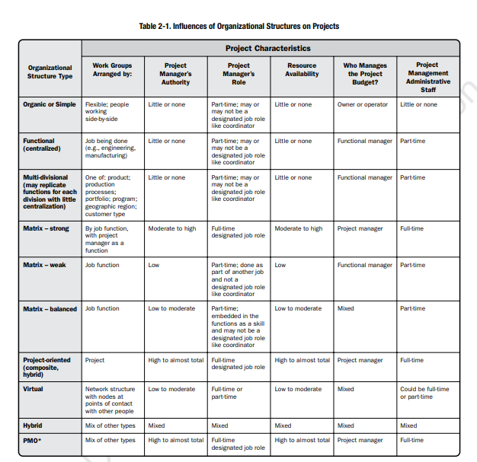
Organizational structures take many forms or types. Table 2-1 compares several types of organizational structures and their influence on projects

Slide 31

2.4.4.2 FACTORS IN ORGANIZATION STRUCTURE SELECTION

Slide 32
Factors to consider in selecting an organizational structure include but are not limited to:
Degree of alignment with organizational objectives,
Specialization capabilities,
Span of control, efficiency, and effectiveness,
Clear path for escalation of decisions,
Clear line and scope of authority,
Delegation capabilities,
Accountability assignment,
Responsibility assignment,
Adaptability of design,
Simplicity of design,
Efficiency of performance,
Cost considerations,
Physical locations (e.g., colocated, regional, and virtual), and
Clear communication (e.g., policies, status of work, and organization’s vision).

Slide 33

2.4.4.3 PROJECT MANAGEMENT OFFICE

Slide 34
There are several types of PMOs in organizations. Each type varies in the degree of control and influence it has onprojects within the organization, such as:
Supportive.
Controlling.
Directive.

Slide 35
A PMO may have the authority to act as an integral stakeholder and a key decision maker throughout the life of eachproject in order to keep it aligned with the business objectives. The PMO may:
Make recommendations,
Lead knowledge transfer,
Terminate projects, and
Take other actions, as required.

Slide 36
A primary function of a PMO is to support project managers in a variety of ways, which may include but are not limited to:
Managing shared resources across all projects administered by the PMO;
Identifying and developing project management methodology, best practices, and standards;
Coaching, mentoring, training, and oversight;
Monitoring compliance with project management standards, policies, procedures, and templates by means of project audits;
Developing and managing project policies, procedures, templates, and other shared documentation (organizational process assets); and
Coordinating communication across projects.

